Slide 1
Delivering a Product Recommendation Engine using DataStax Enterprise (DSE)
Customer:
I'm confused. I saw a presentation at the 2019 DataStax world conference detailing how to deliver a product recommendation engine using DSE Graph. I've also seen DSE articles detailing how to deliver a product recommendation engine using DSE Analytics.
So; Which is it ?
Answer:
Contained within.

Slide 2
Why You Care ..
If You're the CxO ..
After we actually prove our point in these slides, there's 5 slides you may care about. We'll highlight those, or skip ahead.
This preso details 2 entire categories of analytics you likely do not have, and your competition does.
If You're from the Business/Ops Side ..
If You're Technical ..

Slide 3
Why You Care ..
If You're the CxO ..
After we actually prove our point in these slides, there's 5 slides you may care about. We'll highlight those, or skip ahead.
This preso details 2 entire categories of analytics you likely do not have, and your competition does.
If You're from the Business/Ops Side ..
For at least 4 years, there have been analytics capabilities available that you don't have, that will improve your ability to execute.
This isn't just about product recommendation.
If You're Technical ..

Slide 4
Why You Care ..
If You're the CxO ..
After we actually prove our point in these slides, there's 5 slides you may care about. We'll highlight those, or skip ahead.
This preso details 2 entire categories of analytics you likely do not have, and your competition does.
If You're from the Business/Ops Side ..
For at least 4 years, there have been analytics capabilities available that you don't have, that will improve your ability to execute.
This isn’t just about product recommendation.
If You're Technical ..
Your professional life is about to get way more fulfilling.

Slide 5
Agenda:
How to deliver a product recommendation engine using DSE Analytics
How to deliver a product recommendation engine using DSE Graph
When/why to use Graph ?
Graph (query language) primer
(Analytics primer)
This document details-

Slide 6

When/why to use Graph ?
Likely the first question you asked when you heard about graph databases.
And, you likely got a 'hand wavy' response-
"It's a more natural way to think about data ..
(Other, similar)
As the defacto, 40 year old standard; Aren't relational databases more natural ?

Slide 7
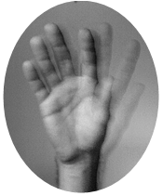
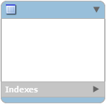
Relational DBs, Graph DBs: Modeling
Relational DB
Graph DB
Customer
Customer
Orders
1:M
Ordered
M:1
Order Items
Stock
This still doesn't tell me why I care-
1:1, M:M, 1:M
Drill down, decompose
Reassemble for use
Relationships, relate

Slide 8

Relational DBs, Graph DBs: Query Language What questions can they answer ?
Can they answer it, Y|N ?
With less code-
Easier to maintain
More performant
The detail in this preso will give you the When/Why.

Slide 9
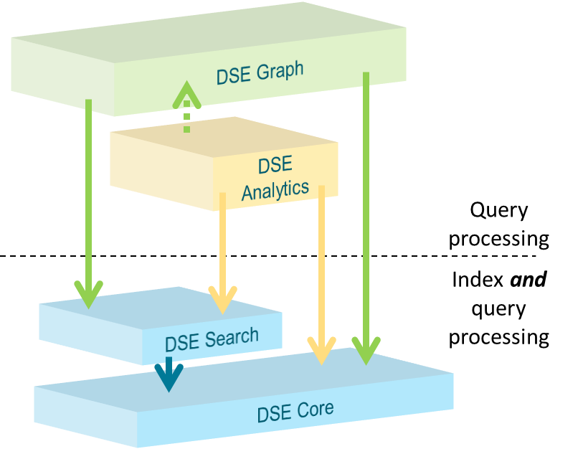
Product Recommendation Engine:
Using DSE Analytics

Slide 10
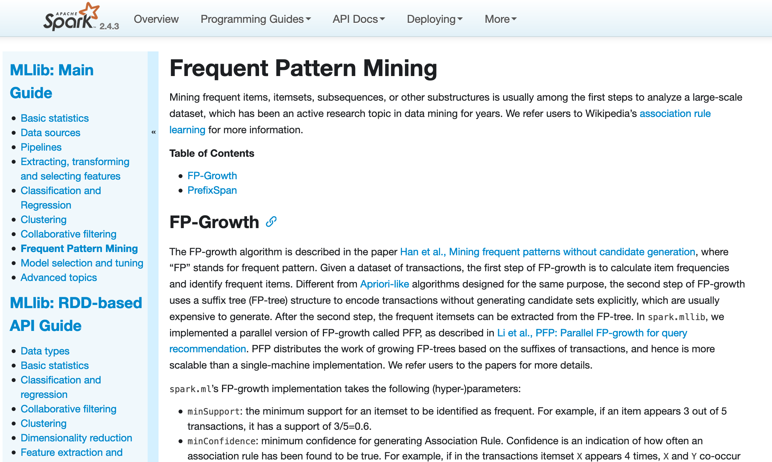

Just 1 of (n) DSE Analytics Pieces: Machine Learning
Machine learning: "an algorithm whose accuracy improves given more data ..
Supervised, Unsupervised
28+ routines out of the box
Years of maturity, highly parallel/performant
Scala/Java, Python, R
Ridiculously vibrant ecosystem
Apache open source
https://spark.apache.org/docs/2.4.3/ml-frequent-pattern-mining.html
https://en.wikipedia.org/wiki/Association_rule_learning

Slide 11
Is Machine Learning (ML) Real ?
What has changed-
Many (AI Winters) between 1965 and now
Now-
Availability of lots of data
Fast/parallel/cheap computers
Focus on weak/narrow AI, not 'General Intelligence (AGI)'
Focus of many companies, mathematicians, universities, researchers
Global scale economies for companies like; Amazon, Google, US-DoD/NSA, Cisco, FedEx, (many more)
Open source, social coding
"Machines will be capable, within 20 years, of doing any work a man can do.
-- Herbert Simon, 1965, Ph.D, IIT
"From three to eight years, we will have a machine with the general intelligence of an average human being.
-- Marvin Minsky, 1970, Ph.D, Princeton, MIT, Turing Award 1969
https://en.wikipedia.org/wiki/Herbert_A._Simon
https://en.wikipedia.org/wiki/Marvin_Minsky

Slide 12
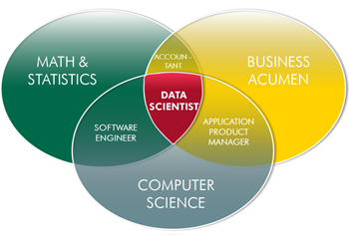
For each ML Routine ..
Given input data format
"Build a model"
Given statistics; routine specific
Disk/CPU intensive, or not
Applying the model, "scoring"
Generally the inverse, intensity-wise of building the model; we'll come back to this fact
Combine with other ML; demographics (clustering)
Real time refreshes/versioning (A-B testing)
You've heard this before; 80%+ of ML time spent is just finding and preparing the data. ML is actually the easy part.

Slide 13
Frequent Pattern Mining: Still 2 years ago, it was ..
"Apriori algorithm"
Gen list of unique (single) items; candidate item set of size 1 (C1). I.e, just Lettuce, just Wine, ..
Then gen list of possible item pairs (C2), then C3, C4, C5, ..
"Support", item-set-count / total-order-count
Soy-milk (left), is 4 / 5 or 80%
"Confidence", Support (A/B) / Support (A)
(Diapers / Wine) / (Diapers) (3/5) / (4/5) == 75%
Drop low Confidence items, they don’t happen anyway
If a C2 is low Confidence, then that same C2 plus another item is also low; Apriori, Latin, 'from before'
If the above pattern holds over large amount of data, we can be 75% certain that a diapers buyer needs/wants wine.

Slide 14

Frequent Pattern Mining: All of the terms ..
"Support", item-set-count / total-order-count
Soy-milk (left), is 4 / 5 or 80%
"Confidence", Support (A/B) / Support (A)
(Diapers / Wine) / (Diapers) (3/5) / (4/5) == 75%
"Lift", Support (A union B) / (Support(A) * Support(B))
Lettuce, Soy milk → Wine 0.2 / (0.4 * 0.6) == 0.83
Equal 1, implies probability of occurrence of antecedent and consequent are independent of one another, no Association Rule should be drawn from these two events
> 1 , degree to which antecedent/consequent are dependent on one another, a useful prediction rule
< 1 , one item has a negative effect on the other and vice versa, items can substitute for one another
Association Rules, next page
Consequent
Antecedent

Slide 15
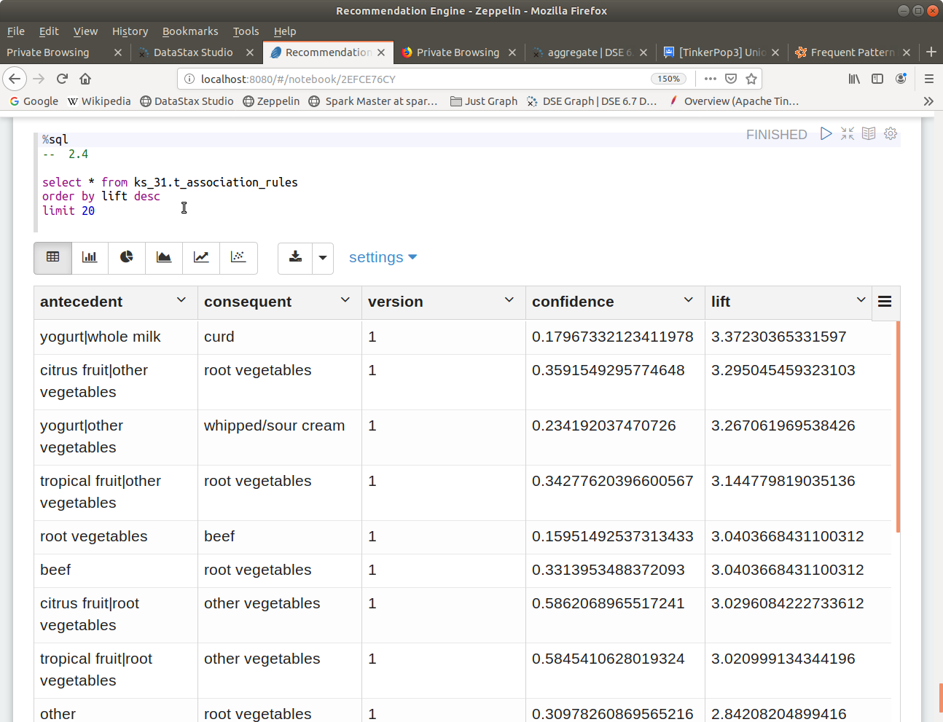
Association Rules: Real Grocery Data ..

Slide 16
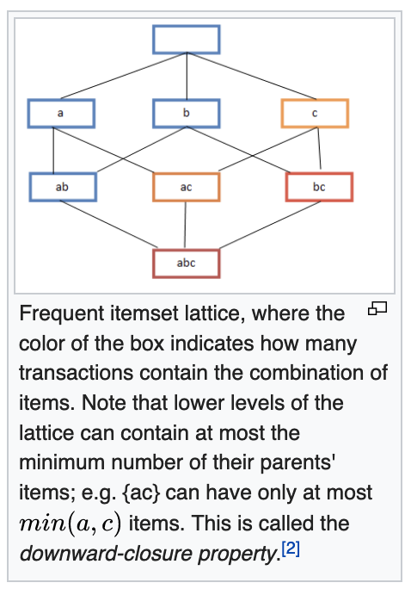
Frequent Pattern Mining: Today ..
Math nerds; "Frequent itemset lattice"
"Focus of many companies, mathematicians, universities, researchers
17x higher performance towards building the model
Same API, (but new statistics added)
Integrated inside DSE, not just a connector
Co-located data, real time analytics
Built in Graph, Solr/Lucene
Same security, logging, H/A, other
https://en.wikipedia.org/wiki/Association_rule_learning

Slide 17

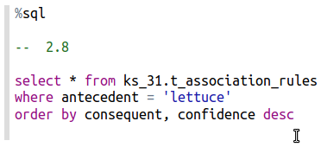
How to Apply a Model (Scoring) ..
To sell, What should we have sorted by ?

Slide 18

All of the Code, End to End ..
// 2.1
import org.apache.spark.ml.fpm.FPGrowth
We chose Scala. Java, Python and R also work.

Slide 19
All of the Code, End to End ..
// 2.2
val recs_0 = sc.textFile("file:///mnt/hgfs/My.20/MyShare_1/18 DSE Developers Notebook/31 Graph Reco Eng/02 Files/10_grocery_sm.csv")
val recs_0s = recs_0.map(i_str => i_str.split(",")).toDF("items")
val my_fpgrowth0 = new FPGrowth().setItemsCol("items").
setMinSupport(0.1).setMinConfidence(0.1)
val my_model0 = my_fpgrowth0.fit(recs_0s)
You have a model; 2 lines

Slide 20
All of the Code, End to End ..
// 2.3
my_model0.associationRules.show()
// +--------------------+-----------+----------+------------------+
// | antecedent |consequent |confidence| lift |
// +--------------------+-----------+----------+------------------+
// | [OJ, diapers, soy..| [lettuce] | 0.5 | 0.625 |
// | [OJ, diapers, soy..| [wine] | 0.5 |0.8333333333333334|
// | [soy milk] | [diapers] | 0.75 | 1.25 |
// | [soy milk] | [OJ] | 0.5 | 1.25 |
// | [soy milk] | [lettuce] | 0.75 | 0.9375 |
// | [soy milk] | [wine] | 0.5 |0.8333333333333334|
// ...

Slide 21
All of the Code, End to End ..
// 2.5
import scala.collection.mutable.WrappedArray;
val recs_0_ar = my_model0.associationRules.collect()
val recs_0_arl = recs_0_ar.map( row => (
row.get(0).asInstanceOf[WrappedArray[WrappedArray[String]]].mkString("|"),
row.get(1).asInstanceOf[WrappedArray[WrappedArray[String]]].mkString("|"),
row.getDouble(2), row.getDouble(3))
).toList
val recs_0_ardf = recs_0_arl.toDF("antecedent",
"consequent", "confidence", "lift")
All prep to write to a database

Slide 22
All of the Code, End to End ..
recs_0_ardf.show(20)
// +---------------------+----------+----------+------------------+
// | antecedent |consequent|confidence| lift |
// +---------------------+----------+----------+------------------+
// | OJ|diapers|soy milk | lettuce | 0.5 | 0.625 |
// | OJ|diapers|soy milk | wine | 0.5 |0.8333333333333334|
// | soy milk | diapers | 0.75 | 1.25 |
// | soy milk | OJ | 0.5 | 1.25 |
// | soy milk | lettuce | 0.75 | 0.9375 |
// | soy milk | wine | 0.5 |0.8333333333333334|
// ...

Slide 23

All of the Code, End to End ..
CREATE TABLE t_association_rules
(
antecedent TEXT,
consequent TEXT,
version DOUBLE,
confidence DOUBLE,
lift DOUBLE,
PRIMARY KEY((antecedent), consequent, version)
) ;
Make a SQL/CQL table

Slide 24
All of the Code, End to End ..
// 2.7
// import org.apache.spark.sql.functions._
val recs_0_ardf2 = recs_0_ardf.withColumn("version", lit(1.0) )
recs_0_ardf2.write.
format("org.apache.spark.sql.cassandra").
options(Map( "keyspace" -> "ks_31", "table" -> "t_association_rules" )).
mode("append").
save

Slide 25
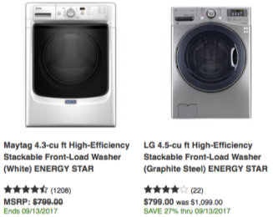
DSE Analytics, Product Reco Engine: Final
2 lines of code to make the model, plus lines to mung data pre/post
This was a "content-based" system, aka, a "product-product" based system
Graph can do this too, and custom
Graph can also do a "collaborative-based", aka, a "user-user" based system, which we do next
You don't have product-product data
Or, you need to predict something that is new, has never happened

Slide 26
Product Recommendation Engine:
Using DSE Graph

Slide 27

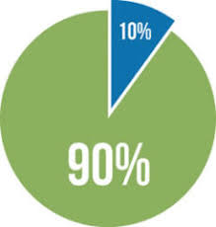
Our Example: Movie Recommendation
Graph Databases
The movie isn't out yet; there aren't years of past data on this one product to draw from
One guy saw an advanced preview of the film, liked it a lot, you have (n) friends in common, persons who have rated (highly) the same things as you in the past, so .. ..
The Model
The Query Language

Slide 28

Here's the entire Query (Traversal) that answers that question..
g.withSack(1,sum).
V().
has("v_user", "user_id", l_user).
sideEffect( out("e_rated").aggregate("se_movieSeenByUser") ).
both("e_knows").
filter(
outE("e_rated").has("rating",gte(l_rate)).
inV().
inE("e_rated").has("rating",gte(l_rate)).
outV().
filter( has("user_id", l_user).and().sack().is(gte(l_conn))) ).
outE("e_rated").has("rating", gte(l_rate)).
inV().
dedup().
where( without("se_movieSeenByUser") ).
order().by( inE("e_rated"). values("rating").mean(), decr).
limit(5).
valueMap("movie_id", "title", "year")
On a 10 scale, this is a 4, but .. .. we know you can't read it right now (you don’t know Graph)
It's simple; we'll teach this to you next

Slide 29
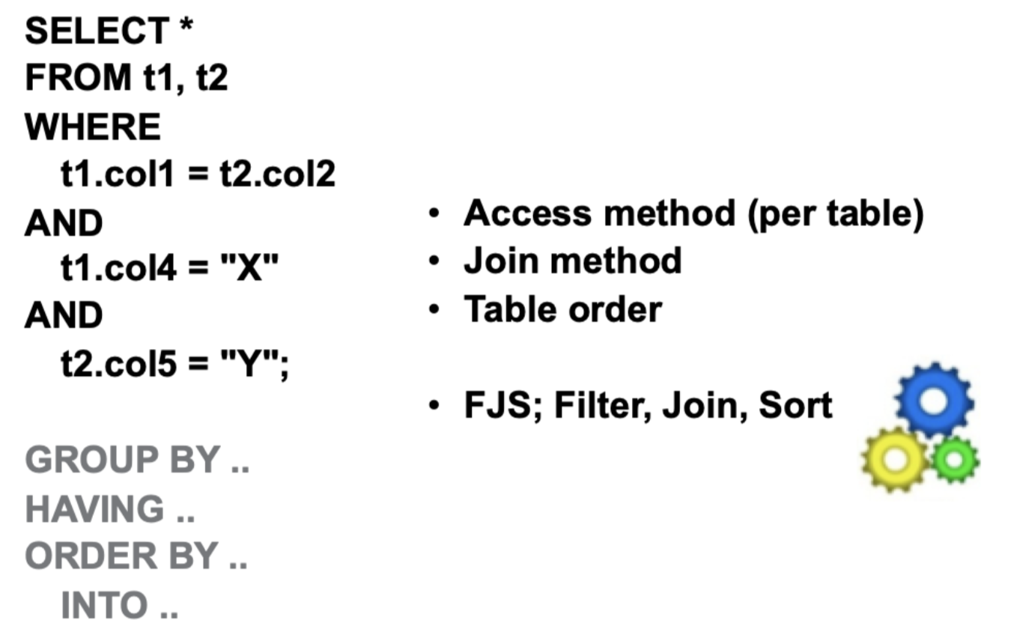

SQL SELECT: the Jewel of SQL
Declarative; say what you want, not how to do it
7 clauses; 2 mandatory, 5 optional
Must appear in order
Each can only appear 1 time
You have zero access/control over the (traversers)
Basically, it's relational Algebra; add, subtract
Yes, CTEs; Diff/Intersect of the above

Slide 30
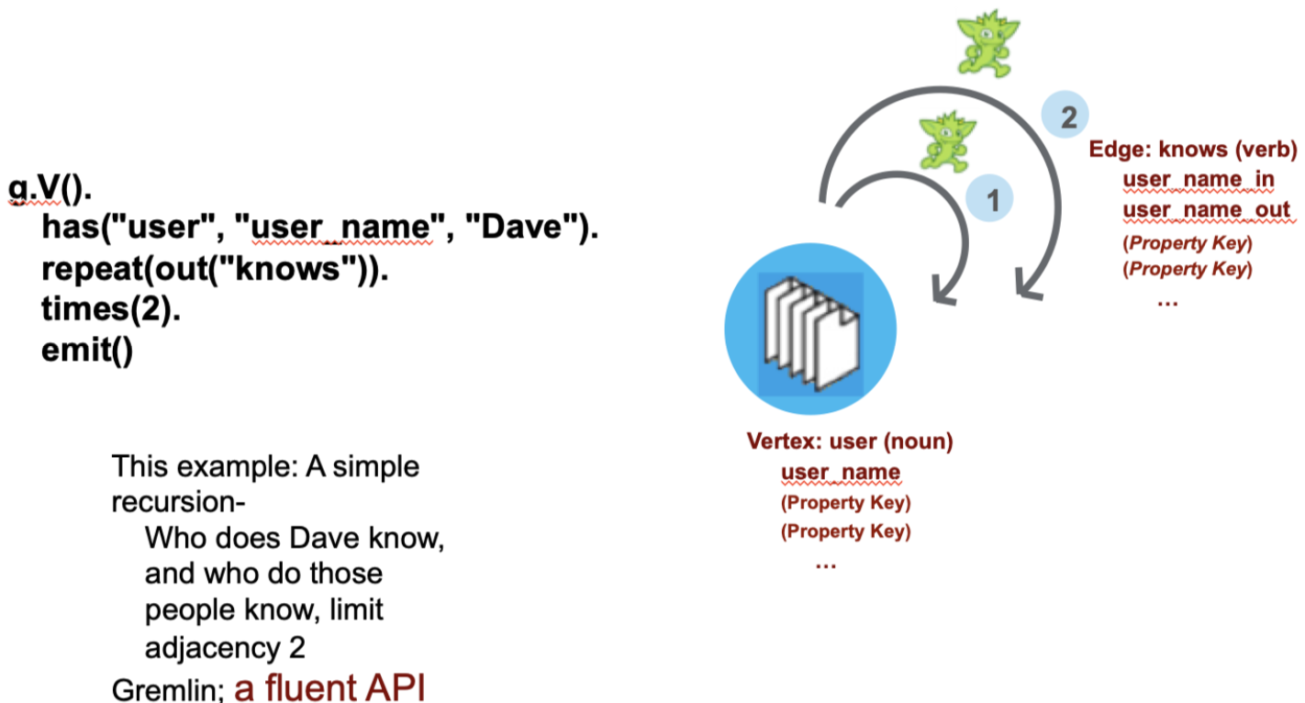
A Simple Graph Database Traversal
Both (imperative, functional), and associative (more on that later)
40+ 'steps' (clauses), plus modifiers; any order, any count (repeat), a fluent API
You can program/direct the traversers (which nearly every other query environment thinks is too hard, and hides)

Slide 31
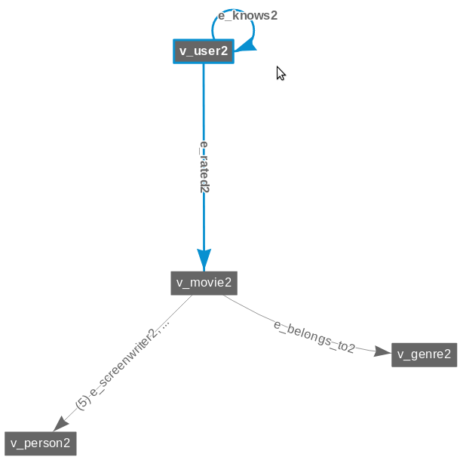

The Model We Use: DataStax Academy 'KillrVideo'
Publicly available thru DS Academy
Think; PrimeVideo, Netflix, Hulu
4 Vertices, many more Edges
A good amount of data (movies)
Don't freak if something is labeled '2'
Sometimes (next) we make a copy
We'll also break off and use custom vertices and edges for test

Slide 32
1
Product Recommendation Engine, Using DSE Graph:
Who Do You "Know" ?

Slide 33
All the Code, End to End: Do you ever really know someone ?
// 4.1
CREATE TABLE user
(
user_id TEXT,
gender TEXT,
age INT,
PRIMARY KEY((user_id))
)
WITH VERTEX LABEL v_user
;
CREATE TABLE knows
(
user_id_s TEXT,
user_id_d TEXT,
PRIMARY KEY((user_id_s), user_id_d)
)
WITH EDGE LABEL e_knows
FROM v_user(user_id_s)
TO v_user(user_id_d);
CREATE MATERIALIZED VIEW e_knows_bi
AS SELECT user_id_s, user_id_d
FROM knows
WHERE
user_id_s IS NOT NULL
AND
user_id_d IS NOT NULL
PRIMARY KEY ((user_id_d), user_id_s);

Slide 34
All the Code, End to End: Data
// 4.2
INSERT INTO user (user_id, gender, age) VALUES
('dave' , 'M', 30 );
...
('denise' , 'F', 30 );
('kiyu' , 'M', 30 );
('farrell', 40 );
('hatcher', 'M', 30 );
('morty' , 'M', 30 );
INSERT INTO knows (user_id_s, user_id_d) VALUES
('farrell', 'kiyu' );
..
('farrell', 'denise' );
('farrell', 'morty' );
('farrell', 'hatcher');
('kiyu' , 'farrell');
('denise' , 'farrell');
('dave' , 'farrell');
('kiyu' , 'denise' );
('kiyu' , 'dave' );
('hatcher', 'denise' );
('kiyu' , 'hatcher');
('denise' , 'dave' );

Slide 35
All the Code, End to End: Hello World (* 2)
// 4.3
def l_user = "farrell"
//
g.V().has("v_user", "user_id", l_user).
out("e_knows").
valueMap(true, "user_id")
// { "id": "v_user:denise#32", "label": "v_user", "user_id": [ "denise" ] },
// { "id": "v_user:hatcher#81", "label": "v_user", "user_id": [ "hatcher" ] },
// { "id": "v_user:kiyu#62", "label": "v_user", "user_id": [ "kiyu" ] },
// { "id": "v_user:morty#77", "label": "v_user", "user_id": [ "morty" ] }

Slide 36
Gremlin: 'Traversal' Steps
From a Vertex (vertex traversal steps)-
out() Given edge labels, move to outgoing adjacent vertices
in() Given the edge labels, move to incoming adjacent vertices
both() (Both above)
outE() Given edges labels, move to outgoing adjacent incident edges
inE() (You get the idea)
bothE()
From an Edge (edge traversal steps)-
outV()
inV()
bothV()
otherV()
Vertex 1
Edge
Vertex 2
https://docs.datastax.com/en/dse/6.7/dse-dev/datastax_enterprise/graph/reference/traversal/tpVertexStepTOC.html

Slide 37
All the Code, End to End: Hello World (* 2)
// 4.4
def l_user = "farrell"
//
g.V().has("v_user", "user_id", l_user).
both("e_knows").
valueMap(true, "user_id")
// farrell knows
// { "id": "v_user:denise#32", "label": "v_user", "user_id": [ "denise" ] },
// { "id": "v_user:hatcher#81", "label": "v_user", "user_id": [ "hatcher" ] },
// { "id": "v_user:kiyu#62", "label": "v_user", "user_id": [ "kiyu" ] },
// { "id": "v_user:morty#77", "label": "v_user", "user_id": [ "morty" ] },
// know farrell (and farrell knows them)
// { "id": "v_user:denise#32", "label": "v_user", "user_id": [ "denise" ] },
// { "id": "v_user:kiyu#62", "label": "v_user", "user_id": [ "kiyu" ] }
// knows farrell, farrell doesn't know him
// { "id": "v_user:dave#38", "label": "v_user", "user_id": [ "dave" ] },

Slide 38
All the Code, End to End: Hello World (* 2)
// 4.5
def l_user = "farrell"
//
g.V().has("v_user", "user_id", l_user).
in("e_knows").
valueMap(true, "user_id")
// in
// { "id": "v_user:dave#38", "label": "v_user", "user_id": [ "dave" ] },
// { "id": "v_user:denise#32", "label": "v_user", "user_id": [ "denise" ] },
// { "id": "v_user:kiyu#62", "label": "v_user", "user_id": [ "kiyu" ] }

Slide 39
The 'as' Step Modulator ..
There is no (default tail) to a traversal; for efficiency
'as' can change that
Think of as (carry forward property keys)
Similar/closest next 2,
store(), think of (derived property keys)
Global to a traversal
withSack(), like store(), but local to a traverser
Also; aggregate(), group(), subGraph(), ..
g.V().
hasLabel("V1).
out("E1")
Vertex
V1
Edge
E1
Vertex
V2
This is what is in (scope) after the out()

Slide 40
'as' Example: Vertex, Edge
// 5.1
CREATE TABLE orders
(
order_id INT,
item TEXT,
PRIMARY KEY((order_id))
)
WITH VERTEX LABEL v_orders
;
CREATE TABLE ordered
(
user_id TEXT,
order_id INT,
order_date TEXT,
PRIMARY KEY((user_id), order_id)
)
WITH EDGE LABEL e_ordered
FROM v_user(user_id)
TO v_orders(order_id);
Previous examples were recursive. Move to a simpler relationship to make things clearer.

Slide 41
'as' Example: Data
INSERT INTO orders (order_id, item) VALUES
(101, 'beer' );
…
(102, 'chips' );
(103, 'wine' );
(104, 'cheese');
INSERT INTO ordered (user_id, order_id, order_date) VALUES
('farrell', 101, 'Dec-31-2008');
…
('farrell', 102, 'Dec-31-2008');
('denise' , 103, 'Dec-31-2008');
('denise' , 104, 'Dec-31-2008');

Slide 42
On the Vertex: What's (in scope), (and also NULL property keys)
// 5.2
def l_user = "farrell"
//
g.V().has("v_user", "user_id", l_user).
valueMap(true)
// { "id": "v_user:farrell#82", "label": "v_user",
// "user_id": [ "farrell" ], "age": [ "40" ] }
// 5.3
def l_user = "denise"
//
g.V().has("v_user", "user_id", l_user).
valueMap(true)
// { "id": "v_user:denise#32", "label": "v_user",
// "gender": [ "F" ], "user_id": [ "denise" ], "age": [ "30" ] }
('denise' , 'F', 30 );
('kiyu' , 'M', 30 );
('farrell', 40 );
('hatcher', 'M', 30 );
('morty' , 'M', 30 );

Slide 43

On the Edge
// 5.4
def l_user = "farrell"
//
g.V().has("v_user", "user_id", l_user).
outE("e_ordered").
valueMap(true)
// { "id": "v_user:farrell#82->e_ordered#03->v_orders:101#27",
// "label": "e_ordered", "order_date": "Dec-31-2008" },
// { "id": "v_user:farrell#82->e_ordered#03->v_orders:102#24",
// "label": "e_ordered", "order_date": "Dec-31-2008" }

Slide 44
Result of out(): (on the adjacent vertex)
// 5.5
def l_user = "farrell"
//
g.V().has("v_user", "user_id", l_user).
out("e_ordered").
valueMap(true)
// { "id": "v_orders:101#27", "label": "v_orders",
// "item": [ "beer" ], "order_id": [ "101" ] },
// { "id": "v_orders:102#24", "label": "v_orders",
// "item": [ "chips" ], "order_id": [ "102" ] }

Slide 45
Finally, 'as' example
// 5.6
def l_user = "farrell"
//
g.V().has("v_user", "user_id", l_user).
as("user").
out("e_ordered").
as("order").
select("user", "order").
by(valueMap(true)).
by(valueMap(true))
// { "user": { "id": "v_user:farrell#82", "label": "v_user", "user_id":
// [ "farrell" ], "age": [ "40" ] }, "order": { "id":
// "v_orders:101#27", "label": "v_orders", "item": [ "beer" ],
// "order_id": [ "101" ] } },
// { "user": { "id": "v_user:farrell#82", "label": "v_user", "user_id":
// [ "farrell" ], "age": [ "40" ] }, "order": { "id":
// "v_orders:102#24", "label": "v_orders", "item": [ "chips" ],
// "order_id": [ "102" ] } }

Slide 46
Why isn't order an embedded array to user ?
Think,
SELECT o.*
FROM user AS 'u'
INNER JOIN order AS 'o'
ON u.user_id=o.user_id

Slide 47
Using 'as'; Do users know each other ?
// 5.7
def l_user = "farrell"
//
g.V().has("v_user", "user_id", l_user).
as('a').
out("e_knows").
as('b').
out("e_knows").
where(eq('a')). // this line
select('a', 'b').
by(values('user_id')).
by(values('user_id'))
// { "a": "farrell", "b": "denise" },
// { "a": "farrell", "b": "kiyu" }
So, (carry forward) to report, and also (carry forward) to evaluate
The 'this line'
"each traverser compares the id value of 'b' to the id value of 'a' and if they aren't equal, then it is filtered out

Slide 48
Back to KillrVideo: Who knows who
// 6.1
def l_user = "u1"
//
g.V().has("v_user2", "user_id", l_user).
valueMap(true)
// { "id": "v_user2:u1#70", "label": "v_user2", "gender": [ "M" ],
// "user_id": [ "u1" ], "age": [ "17" ] }

Slide 49
Back to KillrVideo: Who knows who
// 6.2
def l_user = "u1"
//
g.V().has("v_user2", "user_id", l_user).
as('a').
out("e_knows2").
as('b').
out("e_knows2").
where(eq('a')).
select('a', 'b').
by(values('user_id')).
by(values('user_id'))
// No data

Slide 50
Who knows who: (Debugging)
// 6.3
def l_user = "u1"
//
g.V().has("v_user2", "user_id", l_user).
out("e_knows2").
valueMap(true)
// { "id": "v_user2:u151#66", "label": "v_user2", "gender": [ "M" ],
// "user_id": [ "u151" ], "age": [ "17" ] },
// { "id": "v_user2:u192#77", "label": "v_user2", "gender": [ "F" ],
// "user_id": [ "u192" ], "age": [ "14" ] },
// { "id": "v_user2:u74#16", "label": "v_user2", "gender": [ "F" ],
/ "user_id": [ "u74" ], "age": [ "15" ] },
// { "id": "v_user2:u83#24", "label": "v_user2", "gender": [ "F" ],
// "user_id": [ "u83" ], "age": [ "14" ] }

Slide 51
Who knows who: (Debugging)
// 6.4
def l_user = "u1"
//
g.V().has("v_user2", "user_id", l_user).
in("e_knows2").
valueMap(true)
// { "id": "v_user2:u199#70", "label": "v_user2", "gender": [ "M" ],
// "user_id": [ "u199" ], "age": [ "15" ] }

Slide 52
Who knows who: (Debugging)
// 6.5
def l_user = "u1"
//
g.V().has("v_user2", "user_id", l_user).
both("e_knows2").
valueMap(true)
// { "id": "v_user2:u151#66", "label": "v_user2", "gender": [ "M" ],
// "user_id": [ "u151" ], "age": [ "17" ] },
// { "id": "v_user2:u192#77", "label": "v_user2", "gender": [ "F" ],
// "user_id": [ "u192" ], "age": [ "14" ] },
// { "id": "v_user2:u74#16", "label": "v_user2", "gender": [ "F" ],
// "user_id": [ "u74" ], "age": [ "15" ] },
// { "id": "v_user2:u83#24", "label": "v_user2", "gender": [ "F" ],
// "user_id": [ "u83" ], "age": [ "14" ] },
//
// { "id": "v_user2:u199#70", "label": "v_user2", "gender": [ "M" ],
// "user_id": [ "u199" ], "age": [ "15" ] }

Slide 53
Checkpoint
Umpteen pages just to do a Join ?!
That was an intersection/difference of 2 data sets, to confirm a bi-directional relationship.
And we're building. We've already learned/seen:
has(), hasLabel()
out(), both(), in(), outE()
as()
where()
valueMap()
select().by()
Move to; Do you know them, and do you also have (n) friends in common
Product Recommendation Engine: Using DSE Graph

Slide 54
2
Product Recommendation Engine, Using DSE Graph:
Now You Know Them, Do You Have Friends in Common?

Slide 55
(n) Friends in Common ..
Total set
VALUES ('farrell', 'kiyu' );
VALUES ('farrell', 'denise' );
VALUES ('farrell', 'morty' );
VALUES ('farrell', 'hatcher');
VALUES ('kiyu' , 'farrell');
VALUES ('denise' , 'farrell');
VALUES ('dave' , 'farrell');
VALUES ('kiyu' , 'denise' );
VALUES ('kiyu' , 'dave' );
VALUES ('hatcher', 'denise' );
VALUES ('kiyu' , 'hatcher');
VALUES ('denise' , 'dave' );
After 'has/out'
VALUES ('farrell', 'kiyu' );
VALUES ('farrell', 'denise' );
VALUES ('farrell', 'morty' );
VALUES ('farrell', 'hatcher');
After 'in'
VALUES ('farrell', 'kiyu' );
VALUES ('farrell', 'denise' );
VALUES ('farrell', 'morty' );
VALUES ('farrell', 'hatcher');
VALUES ('kiyu' , 'denise' );
VALUES ('hatcher', 'denise' );
VALUES ('kiyu' , 'hatcher');
After 'filter'
VALUES ('kiyu' , 'denise' );
VALUES ('hatcher', 'denise' );
VALUES ('kiyu' , 'hatcher');
After 'dedup'
{ "user_id": [ "hatcher" ] },
{ "user_id": [ "kiyu" ] }
// 7.1
def l_user = "farrell"
def l_conn = 2
//
g.V().has("v_user", "user_id", l_user).
out("e_knows").
in("e_knows").
filter(
has("user_id", neq(l_user))
).
dedup().
valueMap("user_id")
// { "user_id": [ "hatcher" ] },
// { "user_id": [ "kiyu" ] }

Slide 56
(n) Friends in Common ..
Total set
VALUES ('farrell', 'kiyu' );
VALUES ('farrell', 'denise' );
VALUES ('farrell', 'morty' );
VALUES ('farrell', 'hatcher');
VALUES ('kiyu' , 'farrell');
VALUES ('denise' , 'farrell');
VALUES ('dave' , 'farrell');
VALUES ('kiyu' , 'denise' );
VALUES ('kiyu' , 'dave' );
VALUES ('hatcher', 'denise' );
VALUES ('kiyu' , 'hatcher');
VALUES ('denise' , 'dave' );
After 'has/out'
VALUES ('farrell', 'kiyu' );
VALUES ('farrell', 'denise' );
VALUES ('farrell', 'morty' );
VALUES ('farrell', 'hatcher');
After 'in'
VALUES ('farrell', 'kiyu' );
VALUES ('farrell', 'denise' );
VALUES ('kiyu' , 'denise' );
VALUES ('hatcher', 'denise' );
VALUES ('farrell', 'morty' );
VALUES ('farrell', 'hatcher');
VALUES ('kiyu' , 'hatcher');
After 'filter', just not farrell
VALUES ('kiyu' , 'denise' );
VALUES ('hatcher', 'denise' );
VALUES ('kiyu' , 'hatcher');
After 'filter', 2 or more in common with farrell
VALUES ('kiyu' , 'denise' );
VALUES ('kiyu' , 'hatcher');
After 'dedup'
{ "user_id": [ "kiyu" ] }
// 7.2
def l_user = "farrell"
def l_conn = 2
//
g.withSack(1, sum).
V().has("v_user", "user_id", l_user).
out("e_knows").
in("e_knows").
filter(
sack().is(gte(l_conn)).
and().
has("user_id", neq(l_user))
).
dedup().
valueMap("user_id")
// { "user_id": [ "kiyu" ] }

Slide 57
(n) Friends in Common ..
// 8.1
def l_user = "u1"
def l_conn = 2
//
g.withSack(1, sum).
V().has("v_user2", "user_id", l_user).
out("e_knows2").
both("e_knows2").
filter(
sack().is(gte(l_conn)).
and().
has("user_id", neq(l_user))
).
dedup().
valueMap("user_id")
// { "user_id": [ "u49" ] }

Slide 58
(n) Friends in Common, Debugging ..
// 8.2
def l_user = "u1"
//
g.V().has("v_user2", "user_id", l_user).
out("e_knows2").
valueMap("user_id")
{ "user_id": [ "u151" ] },
{ "user_id": [ "u192" ] },
{ "user_id": [ "u74" ] }, // <--
{ "user_id": [ "u83" ] } // <--

Slide 59
(n) Friends in Common, Debugging ..
// 8.3
def l_user = "u49"
//
g.V().has("v_user2", "user_id", l_user).
both("e_knows2").
valueMap("user_id")
{ "user_id": [ "u132" ] },
{ "user_id": [ "u150" ] },
{ "user_id": [ "u165" ] },
{ "user_id": [ "u435" ] },
{ "user_id": [ "u74" ] }, // <--
{ "user_id": [ "u926" ] },
{ "user_id": [ "u116" ] },
{ "user_id": [ "u122" ] },
{ "user_id": [ "u135" ] },
{ "user_id": [ "u47" ] },
{ "user_id": [ "u54" ] },
{ "user_id": [ "u80" ] },
{ "user_id": [ "u83" ] } // <--

Slide 60
Checkpoint
We've had learned/seen:
has(), hasLabel()
out(), both(), in(), outE()
as()
where()
valueMap()
select().by()
We just added:
filter(), and()
dedup()
withSack(), sack()
Move to; Do you know them, do you also have (n) friends in common, and do you have the same likes ?
Product Recommendation Engine: Using DSE Graph

Slide 61
3
Product Recommendation Engine, Using DSE Graph:
You Know Them, Have Friends in Common, Do You Like the Same Things ?

Slide 62
Like the Same Things ..
// 9.1
def l_user = "u1"
def l_rate = 8
//
g.V().has("v_user2", "user_id", l_user).
outE("e_rated2").
count()
// 32

Slide 63
Like the Same Things ..
// This traversal requires an index
// 9.2
def l_user = "u1"
def l_rate = 8
//
g.V().has("v_user2", "user_id", l_user).
outE("e_rated2").
has("rating",gte(l_rate)).
count()
// 15

Slide 64
Like the Same Things ..
// 9.3
def l_user = "u1"
def l_rate = 8
//
g.V().has("v_user2", "user_id", l_user).
outE("e_rated2").
has("rating", gte(l_rate)).
inV().
inE("e_rated2").
has("rating", gte(l_rate)).
count()
// 962
Yellow is the 'magic'.

Slide 65
Like the Same Things ..
// 9.4
def l_user = "u1"
def l_rate = 8
//
g.V().has("v_user2", "user_id", l_user).
outE("e_rated2").
has("rating", gte(l_rate)).
as("a").
inV().
inE("e_rated2").
has("rating", gte(l_rate)).
as("b").
limit(5).
select("a", "b").
by(valueMap(true)).
by(valueMap(true))
Data next page.

Slide 66
Like the Same Things, Data ..
// {
// "a": { "id": "v_user2:u1#16->e_rated2#10 ->v_movie2:m567#00", "label": "e_rated2", "rating": "10" },
// "b": { "id": "v_user2:u1#16->e_rated2#10 ->v_movie2:m567#00", "label": "e_rated2", "rating": "10" }
// },
// {
// "a": { "id": "v_user2:u1#16->e_rated2#10 ->v_movie2:m567#00", "label": "e_rated2", "rating": "10" },
// "b": { "id": "v_user2:u118#25->e_rated2#10->v_movie2:m567#00", "label": "e_rated2", "rating": "9" }
// },
// {
// "a": { "id": "v_user2:u1#16->e_rated2#10 ->v_movie2:m567#00", "label": "e_rated2", "rating": "10" },
// "b": { "id": "v_user2:u119#24->e_rated2#10->v_movie2:m567#00", "label": "e_rated2", "rating": "8" }
// },
// {
// "a": { "id": "v_user2:u1#16->e_rated2#10 ->v_movie2:m567#00", "label": "e_rated2", "rating": "10" },
// "b": { "id": "v_user2:u125#15->e_rated2#10->v_movie2:m567#00", "label": "e_rated2", "rating": "9" }
// },
// {
// "a": { "id": "v_user2:u1#16->e_rated2#10 ->v_movie2:m567#00", "label": "e_rated2", "rating": "10" },
// "b": { "id": "v_user2:u143#15->e_rated2#10->v_movie2:m567#00", "label": "e_rated2", "rating": "8" }
// }

Slide 67
Like the Same Things ..
// 9.5
def l_user = "u1"
def l_rate = 8
//
g.V().has("v_user2", "user_id", l_user).
outE("e_rated2").
has("rating", gte(l_rate)).
inV().
inE("e_rated2").
has("rating", gte(l_rate)).
//
outV().
has("user_id", neq(l_user)).
dedup().
count()
// 599
Same as 9.3. Add;
Not the target user
Remove duplicates
(Count)

Slide 68
Like the Same Things ..
// 9.6
def l_user = "u1"
def l_rate = 8
//
g.V().has("v_user2", "user_id", l_user).
outE("e_rated2").
has("rating", gte(l_rate)).
inV().
inE("e_rated2").
has("rating", gte(l_rate)).
//
outV().
has("user_id", neq(l_user)).
dedup().
limit(5).
valueMap(true)
Same as 9.5. Data view

Slide 69
Like the Same Things, Data ..
// { "id": "v_user2:u1027#65", "label": "v_user2", "gender": [ "F" ], "user_id": [ "u1027" ], "age": [ "22" ] },
// { "id": "v_user2:u106#14" , "label": "v_user2", "gender": [ "F" ], "user_id": [ "u106" ], "age": [ "14" ] },
// { "id": "v_user2:u168#22" , "label": "v_user2", "gender": [ "M" ], "user_id": [ "u168" ], "age": [ "15" ] },
// { "id": "v_user2:u19#77" , "label": "v_user2", "gender": [ "F" ], "user_id": [ "u19" ], "age": [ "13" ] },
// { "id": "v_user2:u2#19" , "label": "v_user2", "gender": [ "M" ], "user_id": [ "u2" ], "age": [ "12" ] }

Slide 70
Checkpoint
You know them
Have friends in common
Like the same things
What's the affinity; Do you like the same things ALOT ?
Product Recommendation Engine: Using DSE Graph

Slide 71
Like the Same Things, Alot ..
// 9.7
def l_user = "u1"
def l_rate = 8
def l_count = 5
//
g.withSack(1, sum).
V().has("v_user2", "user_id", l_user).
outE("e_rated2").
has("rating", gte(l_rate)).
inV().
inE("e_rated2").
has("rating", gte(l_rate)).
//
outV().
filter(
sack().is(gte(l_count)).
and().
has("user_id", neq(l_user))
).
dedup().
valueMap(true)
This (aggregate/count) is per user

Slide 72
Like the Same Things, A lot, Data ..
// { "id": "v_user2:u156#69", "label": "v_user2", "gender": [ "F" ], "user_id": [ "u156" ], "age": [ "15" ] },
// { "id": "v_user2:u119#78", "label": "v_user2", "gender": [ "M" ], "user_id": [ "u119" ], "age": [ "17" ] },
// { "id": "v_user2:u13#17", "label": "v_user2", "gender": [ "M" ], "user_id": [ "u13" ], "age": [ "14" ] },
// { "id": "v_user2:u143#65", "label": "v_user2", "gender": [ "F" ], "user_id": [ "u143" ], "age": [ "17" ] },
// { "id": "v_user2:u4#67", "label": "v_user2", "gender": [ "F" ], "user_id": [ "u4" ], "age": [ "16" ] },
// { "id": "v_user2:u85#22", "label": "v_user2", "gender": [ "M" ], "user_id": [ "u85" ], "age": [ "13" ] }
More data ?!
We dropped the limit()

Slide 73
Checkpoint
Movies, Friends, Likes, (Affinity); Seems trivial, right ?!
Um, no.
The preceding is the very same pattern we use for:
Entity resolution; Is this the same person, fraud
Across vertices, (person, time, location, ..); Impact analysis
And, the preceding was all programmed/imperative. We don’t even cover a seminal use case for Graph (matching) in this preso.
Product Recommendation Engine: Using DSE Graph

Slide 74
4
We've had learned/seen:
has(), hasLabel()
out(), both(), in(), outE()
as()
where()
valueMap()
select().by()
filter(), and(), gte()
dedup(), limit(), count()
withSack(), sack()
Last adds: sideEffect(), where((without())
Like a (streaming) branch in a traversal; a data set you can refer to later in the traversal
In context; Don't recommend to me movies I've already seen
Product Recommendation Engine, Using DSE Graph:
You Know Them, Have Friends in Common, Do You Like the Same Things, What are those things different from my things ?

Slide 75
What Things Did we Start With ..
// 10.1
def l_user = "u1"
def l_rate = 8
//
g.V().has("v_user2", "user_id", l_user).
outE("e_rated2").
count()
// 32
All ratings

Slide 76
What Things Did we Start With ..
// 10.2
def l_user = "u1"
def l_rate = 8
//
g.V().has("v_user2", "user_id", l_user).
outE("e_rated2").
has("rating",lt(l_rate)).
count()
// 17
To show (differences in isolation), we need a new dataset; things we don't like

Slide 77
What Things Did we Start With ..
// 10.3
def l_user = "u1"
def l_rate = 8
//
g.V().has("v_user2", "user_id", l_user).
outE("e_rated2").
has("rating",gte(l_rate)).
count()
// 15
Things we like; old topic

Slide 78
What Things Did we Start With ..
// 10.4
def l_user = "u1"
def l_rate = 8
//
g.V().has("v_user2", "user_id", l_user).
sideEffect(
outE("e_rated2").
has("rating",lt(l_rate)).
aggregate("a")
).
outE("e_rated2").
count()
// 32
Building, no effect yet

Slide 79
What Things Did we Start With ..
// 10.5
def l_user = "u1"
def l_rate = 8
//
g.V().has("v_user2", "user_id", l_user).
sideEffect(
outE("e_rated2").
has("rating",lt(l_rate)).
aggregate("a")
).
outE("e_rated2").
where(without("a")).
count()
// 15
Showing the (set difference) technique; there was obviously an easier way to do this

Slide 80
What Things Did we Start With ..
// 10.6
def l_user = "u1"
def l_rate = 8
//
g.V().has("v_user2", "user_id", l_user).
sideEffect(
outE("e_rated2").
has("rating",lt(l_rate)).
aggregate("a")
).
outE("e_rated2").
where(without("a")).
valueMap(true)
Same as 10.5. Data view

Slide 81
What Things Did we Start With, Data ..
// { "id": "v_user2:u1#16->e_rated2#10->v_movie2:m102#07", "label": "e_rated2", "rating": "8" },
// { "id": "v_user2:u1#16->e_rated2#10->v_movie2:m111#05", "label": "e_rated2", "rating": "10" },
// { "id": "v_user2:u1#16->e_rated2#10->v_movie2:m160#03", "label": "e_rated2", "rating": "8" },
// { "id": "v_user2:u1#16->e_rated2#10->v_movie2:m223#07", "label": "e_rated2", "rating": "8" },
// { "id": "v_user2:u1#16->e_rated2#10->v_movie2:m28#62", "label": "e_rated2", "rating": "9" },
// ...

Slide 82
Checkpoint
You now have all of the techniques.
Final Assembly-
(We saw this much earlier)
Product Recommendation Engine: Using DSE Graph

Slide 83
Final Assembly-
g.withSack(1,sum).
V().
has("v_user", "user_id", l_user).
sideEffect( out("e_rated").aggregate("se_movieSeenByUser") ).
both("e_knows").
filter(
outE("e_rated").has("rating",gte(l_rate)).
inV().
inE("e_rated").has("rating",gte(l_rate)).
outV().
filter( has("user_id", l_user).and().sack().is(gte(l_conn))) ).
outE("e_rated").has("rating", gte(l_rate)).
inV().
dedup().
where( without("se_movieSeenByUser") ).
order().by( inE("e_rated"). values("rating").mean(), decr).
limit(5).
valueMap("movie_id", "title", "year")
Normally hours of training to get here, but ..
We expect you can generally read/ understand this, (if not certainly write it from scratch using these notes)
Did the concepts make sense ?

Slide 84
Final Assembly, Data -
// { "movie_id": [ "m278" ], "title": [ "The Simpsons (TV Series)" ], "year": [ "1989" ] },
// { "movie_id": [ "m274" ], "title": [ "One Flew Over the Cuckoos Nest" ], "year": [ "1975" ] },
// { "movie_id": [ "m13" ], "title": [ "The Pianist" ], "year": [ "2002" ] },
// { "movie_id": [ "m163" ], "title": [ "The Good', ' the Bad and the Ugly" ], "year": [ "1966" ] },
// { "movie_id": [ "m351" ], "title": [ "Forrest Gump" ], "year": [ "1994" ] }

Slide 85
Delivering a Product Recommendation Engine using DataStax Enterprise (DSE)
Customer:
I'm confused. I saw a presentation ... product recommendation engine using DSE Graph … product recommendation engine using DSE Analytics.
Answer:
Do you need (have data to support) 'content based' or 'collaborative based' product recommendation ?
Collaborative based product recommendation has elements of entity resolution, associative analysis, other; Do you need this business intelligence too ?
Graph (scalable graph) has to be in your toolbox, as should predictive analytics (machine learning) . Where stand Yee with that ?

Slide 86
Thank you (Thanks also to; Dave Bechberger, Artem Chebotko)

Slide 87
Resources:
This document and all related resources are available at,
tinyurl.com/ddn3000
You want the July/2019 dated set of
artifacts.

Slide 88
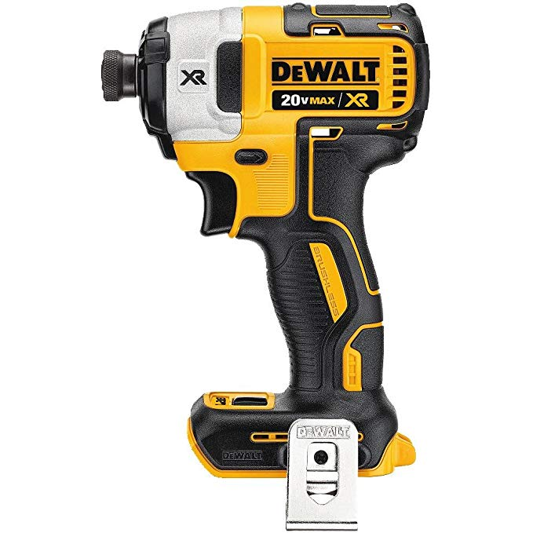

Can Graph Traversals Replace SQL Queries ?
That's a qualitative (not quantitative) question-
Functionally, Yes
Performance, for some/many cases, ??
Each were designed to solve a different problem; minimally, to solve the (same ?) problem differently

Slide 89
Dave.B's: 5 Step Graph Trough of Despair
g.V().hasNot(simplePath())- The 5 Stages of your Graph Database Journey
Excitement - Graph Databases are awesome, They can solve all my problems
Confusion - I don't understand, How do I get it this to work
Frustration - Why won't this stupid query give me the right answer
Anger - This thing is broken, I hate graph
Acceptance - Ok this thing is pretty awesome for some things but not good at others

